Slide 1


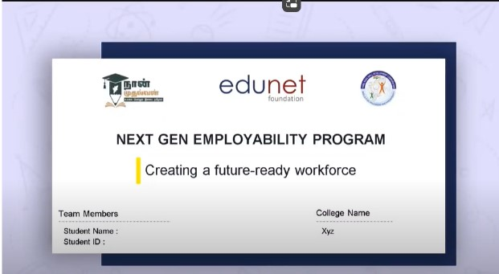
NEXT GEN EMPLOYABILITY PROGRAM
Creating a future-ready workforce
Team Members
College Name
………………………………………...............
………………………………………...............
Student Name : THRISHA N
Student ID : au613021104118
VIVEKANANDHA COLLEGE OF TECHNOLOGY FOR WOMEN

Slide 2
CAPSTONE PROJECT SHOWCASE
Project Title
Notes Sharing Web Application using Django Framework
Abstract | Problem Statement | Project Overview | Proposed Solution | Technology Used | Modelling & Results | Conclusion

Slide 3

Next Gen Employability Program
Abstract
My project focuses on creating an innovative notes sharing web application utilizing Python and Django technologies. The platform provides a centralized hub for users to create, share, and collaborate on notes, fostering a dynamic learning ecosystem. With a focus on user privacy and data security, the application employs robust encryption and access control mechanisms, ensuring confidentiality and integrity of shared content.

Slide 4
Next Gen Employability Program
Problem Statement
Implement access control and permission management functionalities, allowing users to control who can view, edit, and share their notes, ensuring privacy and data security.

Slide 5
Next Gen Employability Program
Project Overview
The proposed solution aims to develop a robust notes sharing web application using Python with the Django framework. This application will facilitate seamless sharing and collaboration on notes among users, providing a user-friendly interface and robust security measures.
Our Notes Sharing Web Application built on Python with the Django framework has laid a strong foundation for collaborative note-taking and sharing. However, to ensure its continued relevance and competitiveness in the ever-evolving landscape of digital collaboration tools, we propose several future enhancements aimed at enriching user experience, enhancing functionality, and optimizing performance.

Slide 6
Next Gen Employability Program
Proposed Solution
Implement a robust search functionality allowing users to easily find specific notes based on keywords, tags, or categories.
Provide users with customizable profiles where they can manage their preferences, view shared notes, and connect with other users.
Employ best practices for security, including encryption of sensitive data, protection against common web vulnerabilities such as CSRF and XSS attacks, and secure storage of user credentials.
Develop a responsive web design ensuring the application is accessible and functional across various devices and screen sizes.
Provide an admin dashboard with tools to manage users, monitor activity, and moderate content.

Slide 7
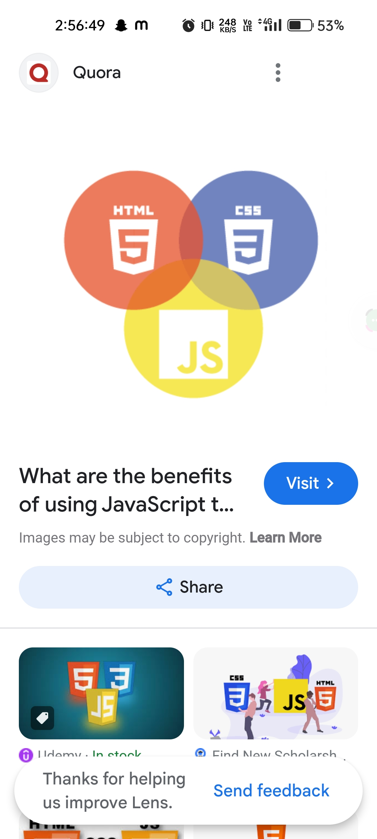

Next Gen Employability Program
Technologies Used
Frontend
Backend

Slide 8
Next Gen Employability Program
Modelling & Results
Python: Utilize Python as the primary programming language for backend development due to its simplicity, versatility, and extensive libraries.
Django Framework: Leverage the Django framework for rapid development, built-in security features, and scalability.
HTML/CSS/JavaScript: Use these technologies for frontend development to create an intuitive and interactive user interface.
SQLite/PostgreSQL: Employ SQLite during development for its simplicity and switch to PostgreSQL for production for better scalability and performance.
RESTful API: Develop a RESTful API to facilitate communication between the frontend and backend, enabling seamless integration with other platforms and services.

Slide 9
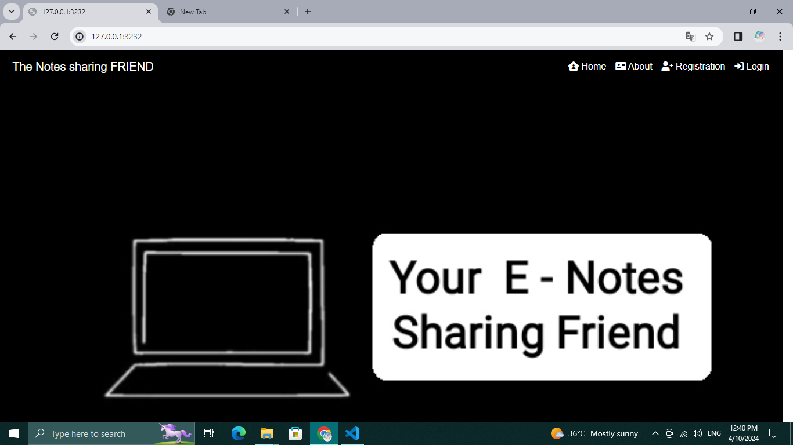
Next Gen Employability Program
Home Page

Slide 10
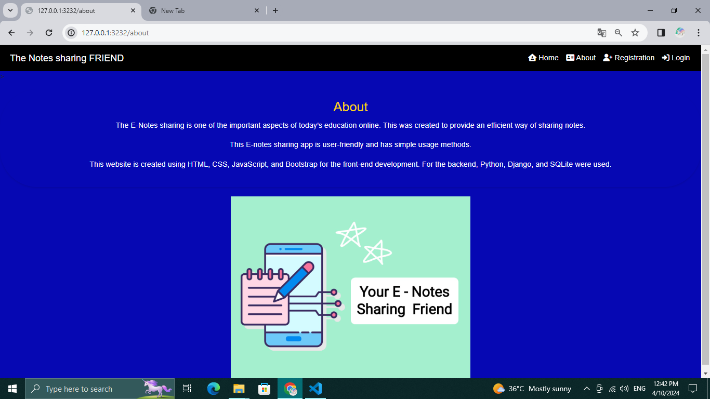
Next Gen Employability Program
About

Slide 11
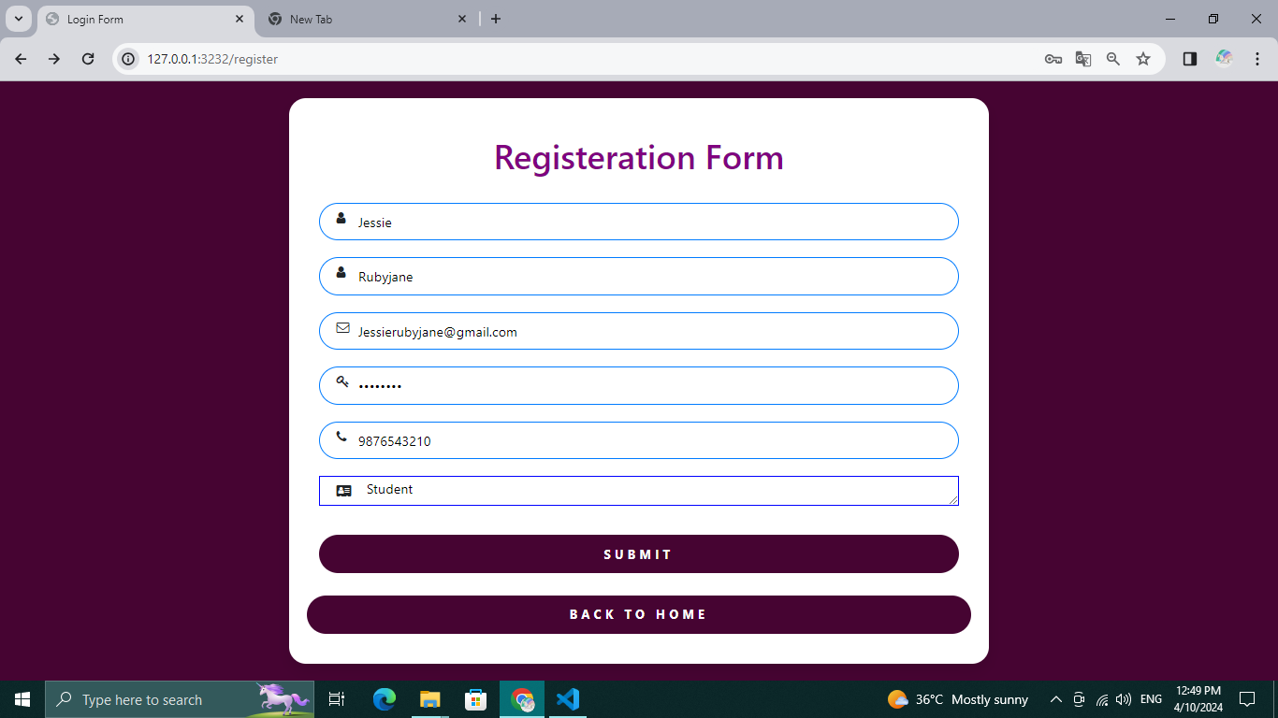
Next Gen Employability Program
Registration page

Slide 12
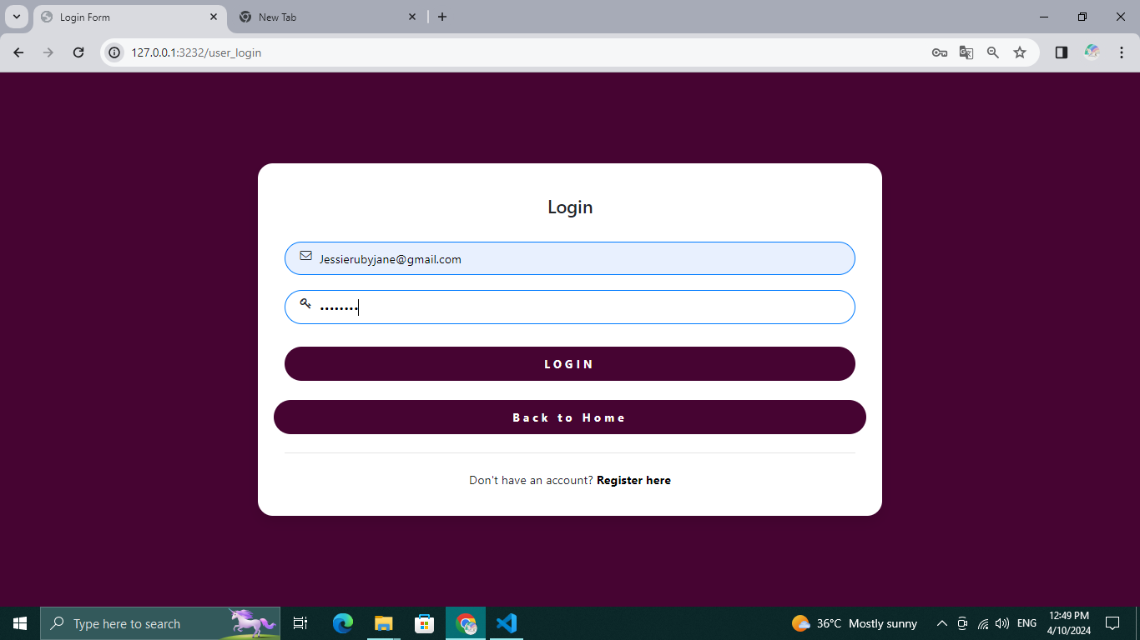
Next Gen Employability Program
Login Page

Slide 13
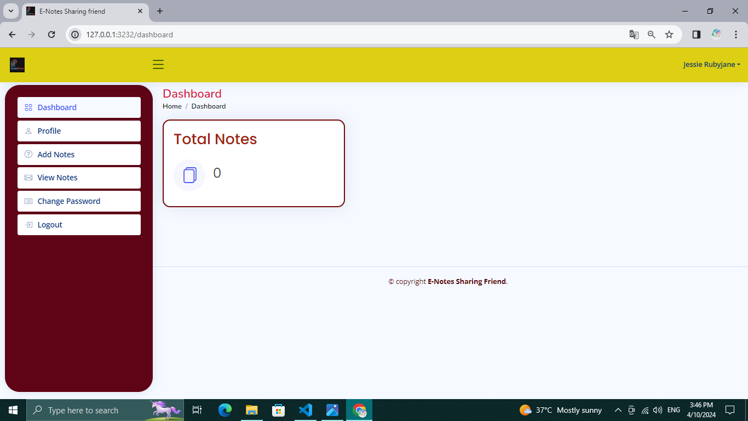
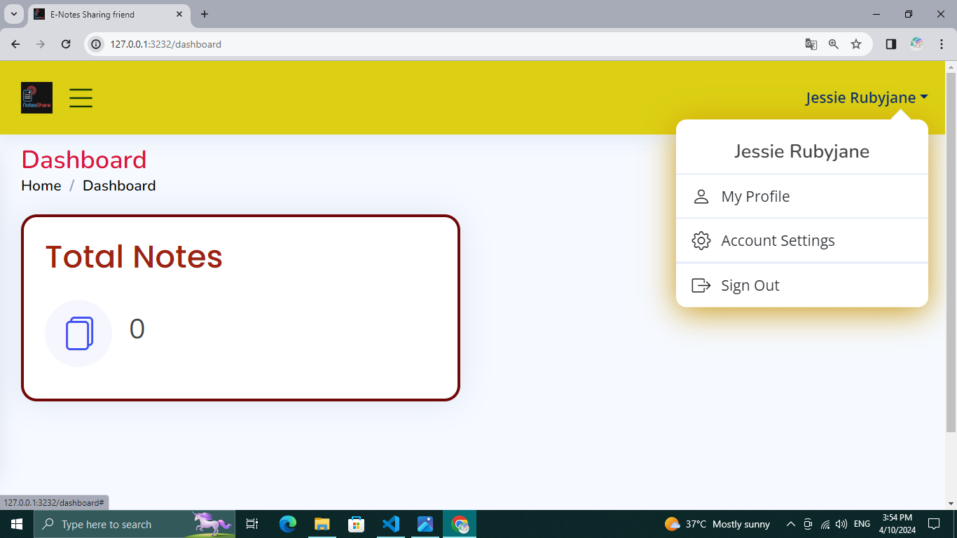
Next Gen Employability Program
Dashboard

Slide 14
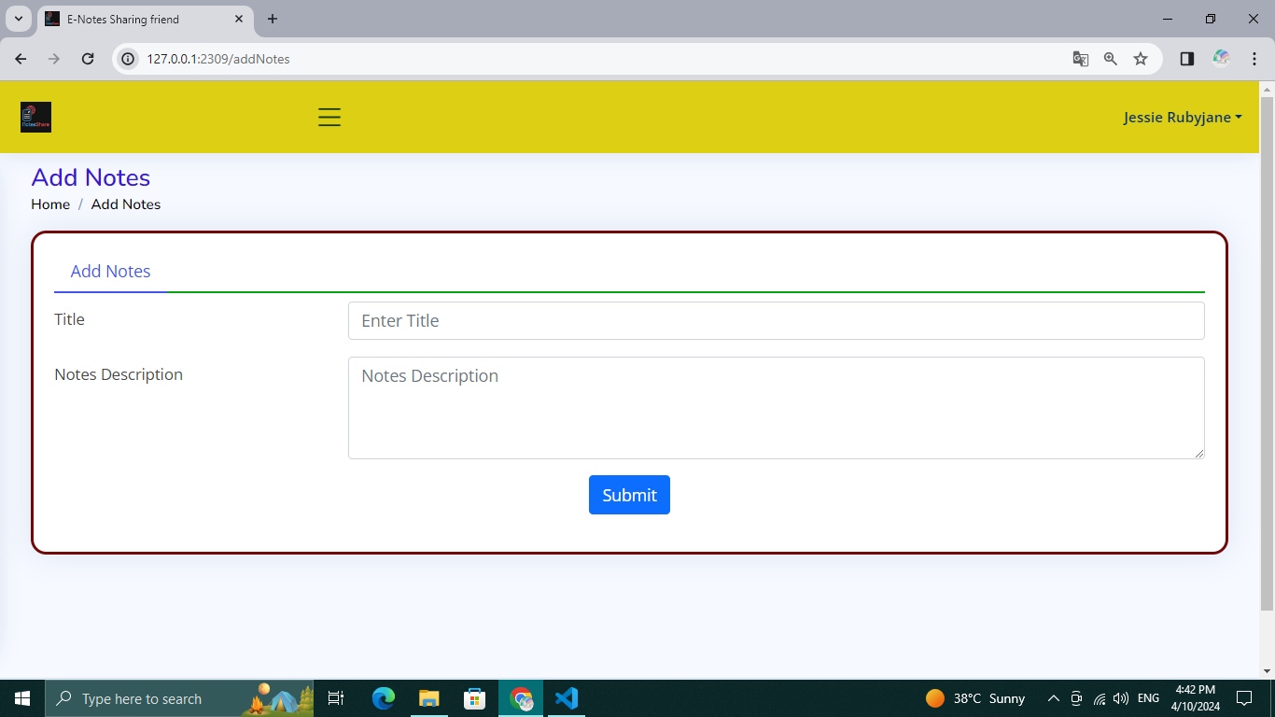
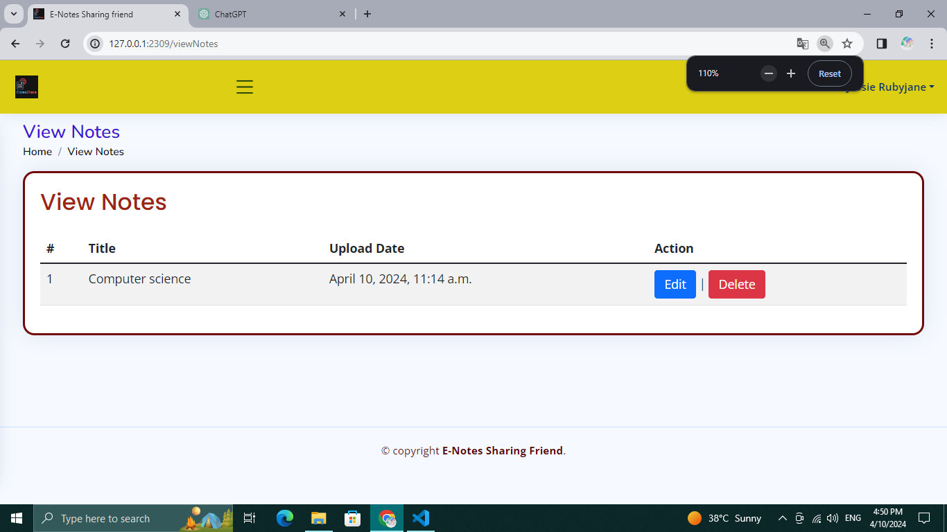
Next Gen Employability Program
Notes uploading and viewing

Slide 15
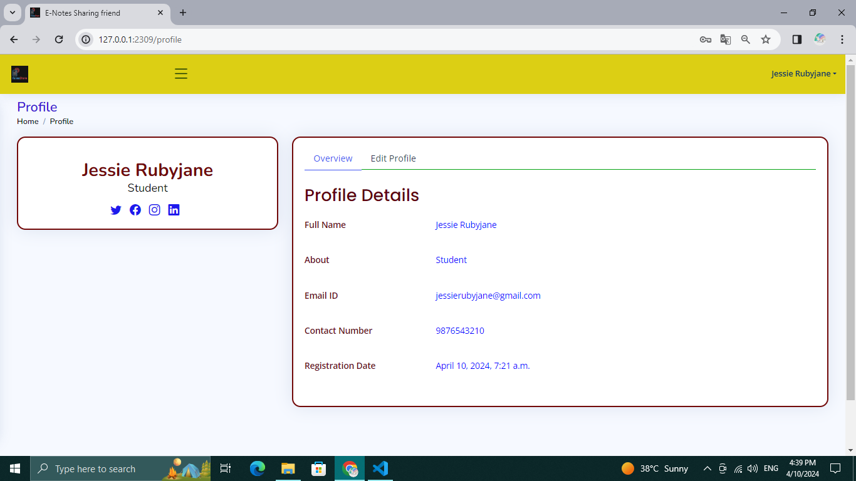
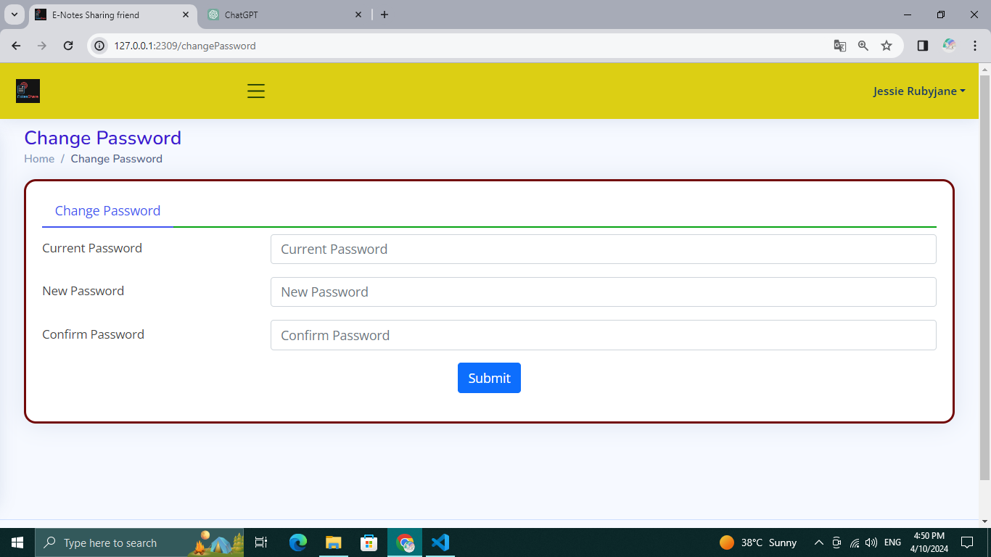
Next Gen Employability Program
Profile and password changing

Slide 16
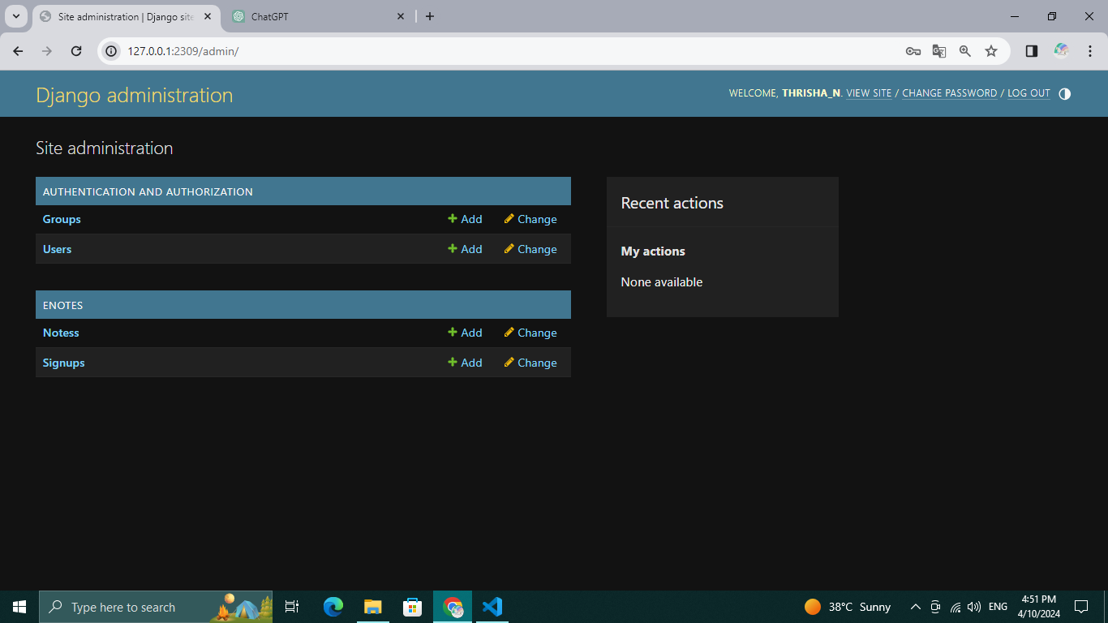
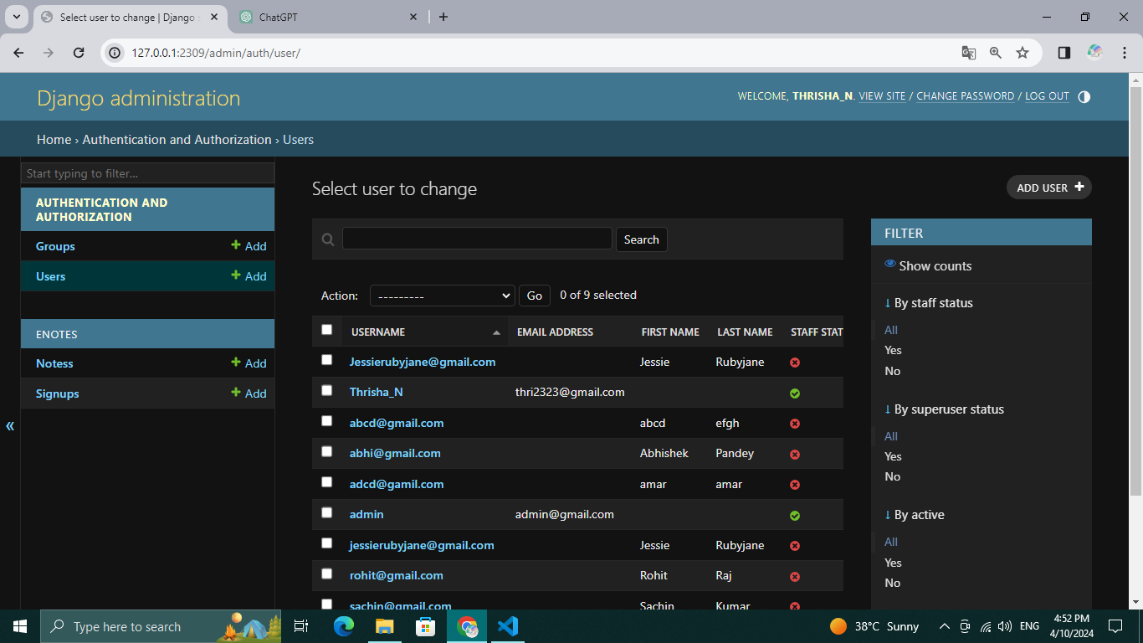
Next Gen Employability Program
ADMIN

Slide 17
Next Gen Employability Program
Future Enhancements
Personalization and Customization:
Enable users to personalize their note-taking experience by customizing themes, layouts, and preferences.
Allow users to create custom categories, tags, or folders to organize their notes more efficiently.
Offline Access and Sync:
Develop an offline mode feature, allowing users to access and edit notes even when not connected to the internet.
Implement synchronization mechanisms to automatically sync changes made offline once the user reconnects to the internet.

Slide 18
Next Gen Employability Program
Conclusion
The Notes Sharing Web Application is poised to revolutionize the way users create, manage, and share notes online. With its intuitive interface, powerful features, and robust architecture, the application promises to streamline workflows, foster collaboration, and elevate productivity. Through continuous improvement and user feedback, we aim to create a platform that meets the evolving needs of my users and remains a valuable tool for personal and professional use.

Slide 19
Next Gen Employability Program
Thank You !

